Slide 1
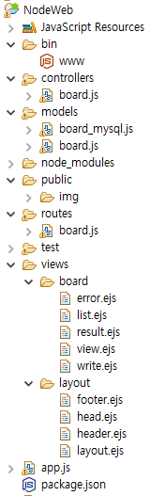
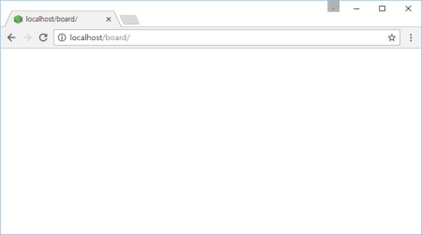

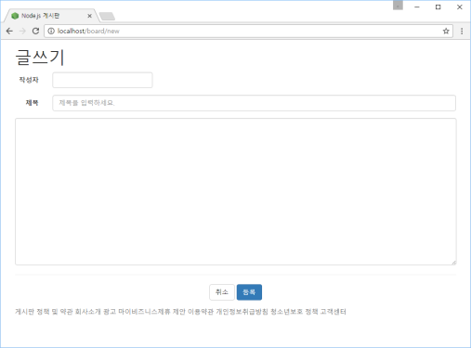
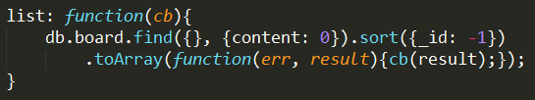
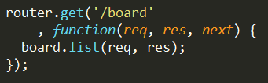
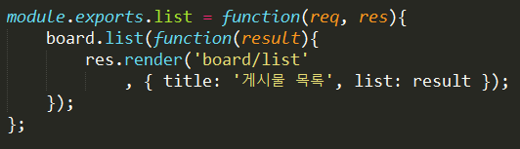
http://localhost/board 요청
Controller
Web browser
www
app.js
2
logger
bodyParser
1
cookieParser
Model
static 자원처리
board.js
session
......
routes
6
3
MongoDB
9
5
View
error handling
header.ejs
layout.ejs
7
4
board.js
body
footer.ejs
list.ejs
8
layout.ejs
view engine(ejs)

Slide 2
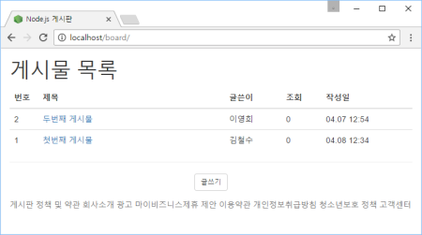
Controller
www
app.js
routes
bodyParser
board.js
cookieParser
Model
session
...
controllers
routes
error handling
board.js
board.js
View
MongoDB
layout.ejs
Oracle
MySQL
list.ejs

